Slide 1
Graphical output and conditions
Lesson 5

Slide 2
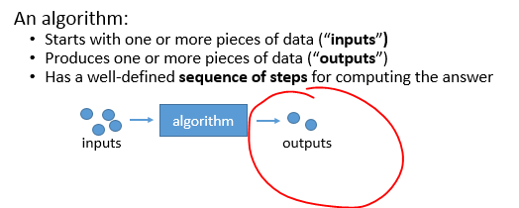
including graphics
Including animation

Slide 3
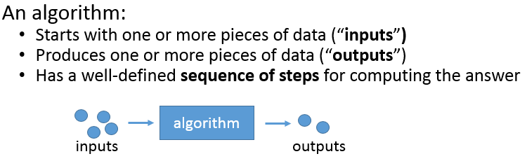
including decisions

